Slide 1
MODULE LOG PARSER
By
Ruhi Shaik
Pahuljeet Kaur
Alekhya Saripella
Mary Gudise
Anwesha Anurakta

Slide 2
CONTENTS
Introduction
Software Resources
Input Log File
Validation of messages
Designing
UML Diagrams
Directory Structure

Slide 3
Introduction
Module log Parser displays the valid messages of the given module present in the input log file.
It performs validation on all the log messages of the module and differentiates between valid and invalid log messages.
It stores the identified invalid log messages in valid log file.
It stores the valid log messages according to the log message type.

Slide 4
Software Resources
C++
Linux
Valgrind
Cpp Unit
OOPs

Slide 5
Input Log File
If the log message are not following the format they are the invalid log messages.
Example:
Module name: algo
11 algo FATAL e directory found

Slide 6
Designing
Multilevel Inheritance:
Derivation of a class from another derived class is called Multilevel Inheritance.
Class Message is the base class for the derived class Module, which in turn serves as a base class for the derived class Parser. Class Module provides a link for the inheritance between message and parser and is known as an intermediate base class.
Standard Template Library[STL]:Multimap
Multimap is similar to a map with the addition that multiple elements can have the same keys.
These properties of multimap make it very much useful in competitive programming.

Slide 7
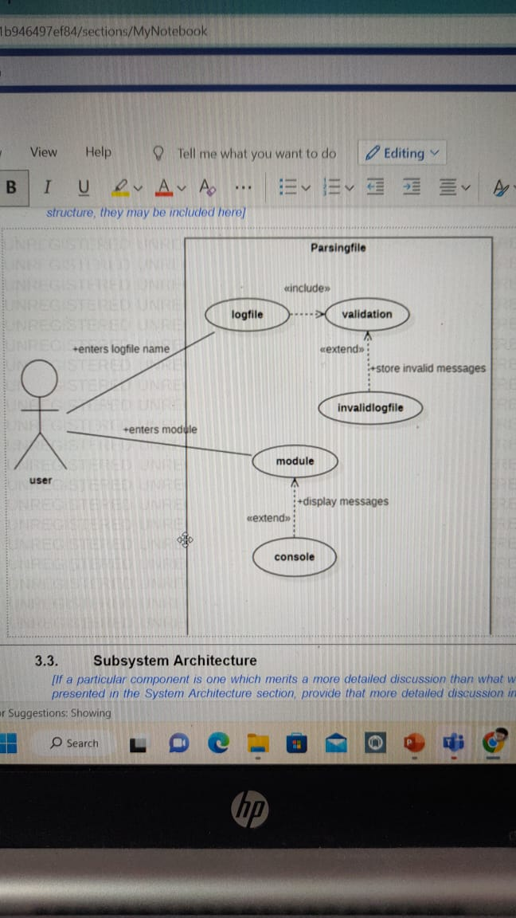
Use Case Diagram

Slide 8
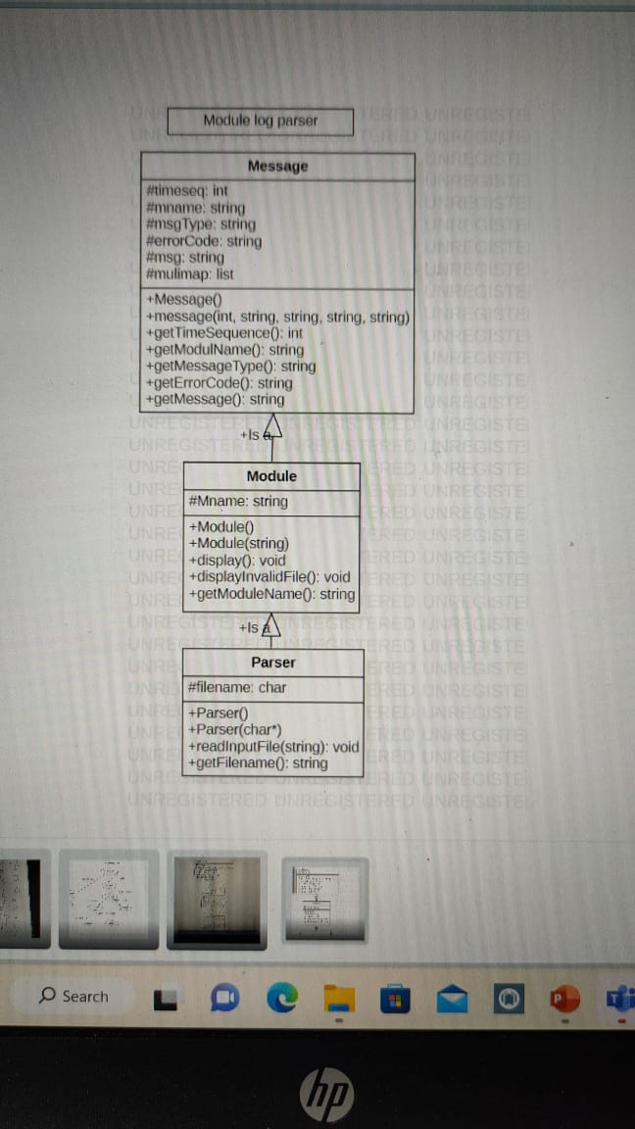
Class Diagram

Slide 9
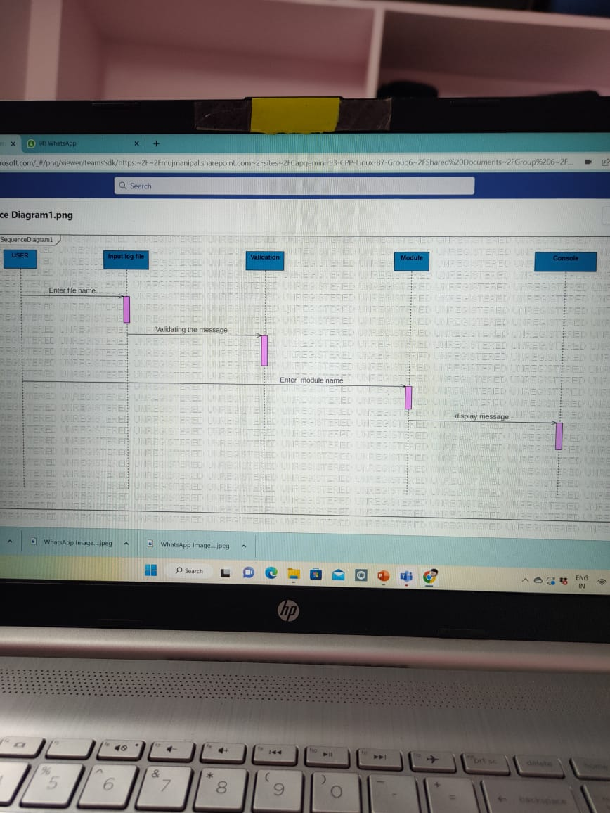
Sequence Diagram

Slide 10
Directory Structure
Src, include, bin, obj, make file, tools and cpp unit.
Include directory contains:
Message.h
Module.h
Parser.h
Src directory contains:
Message.cpp
Module.cpp
Parser.cpp
Main.cpp
Makefile directory contains:
Makefile
Bin directory contains:
Tester executable file
Obj directory contains
.o file

Slide 11
Tools directory contains:
Valgrind directory
Cppunit directory

Slide 12
Thank You

